Slide 1

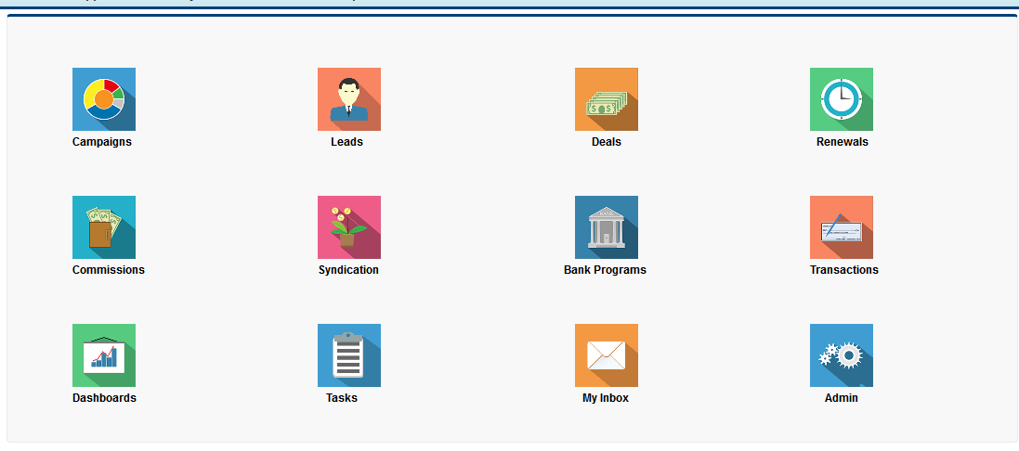
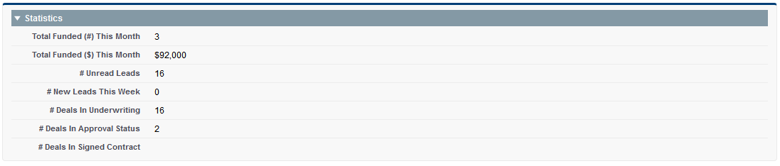
MCA Home

Slide 2
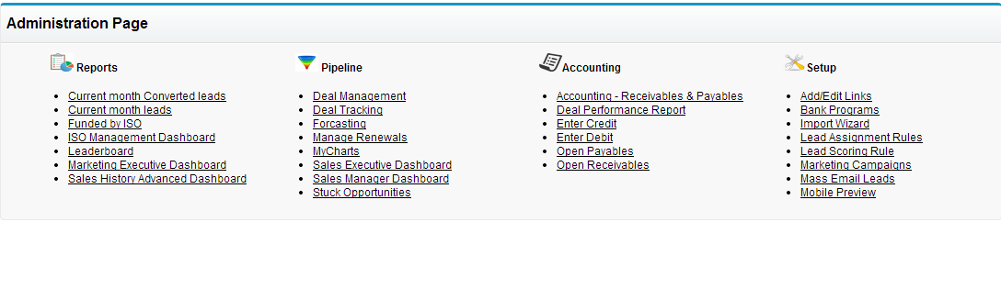
Administration Page

Slide 3
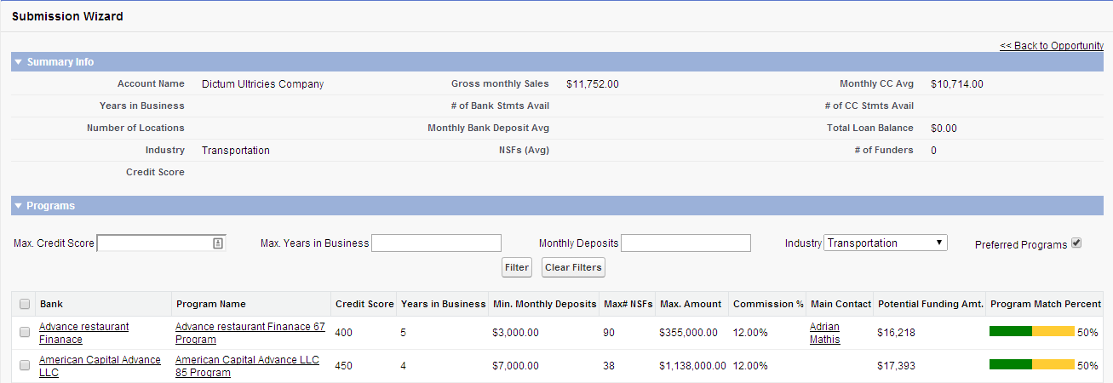
Submission Wizard
Notes:
Test

Slide 4
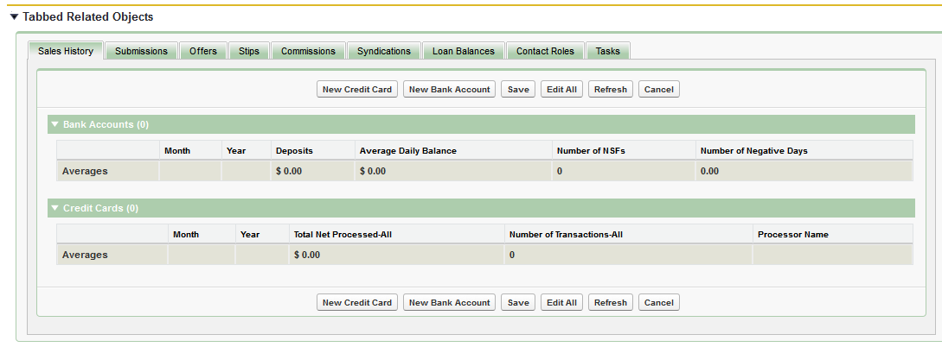
Opportunity Grid

Slide 5
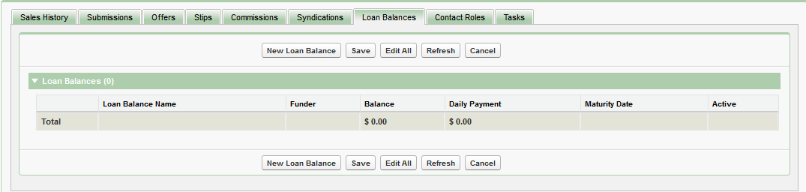
Opportunity Grid - Loan Balance

Slide 6
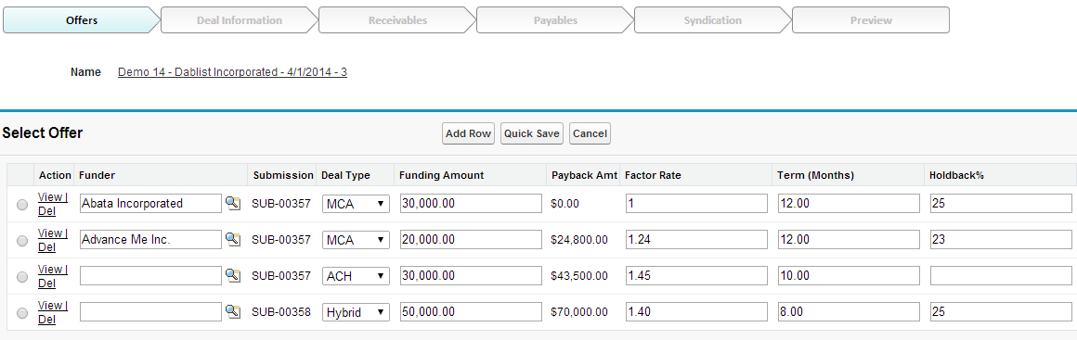
Deal Entry Wizard – Offers

Slide 7
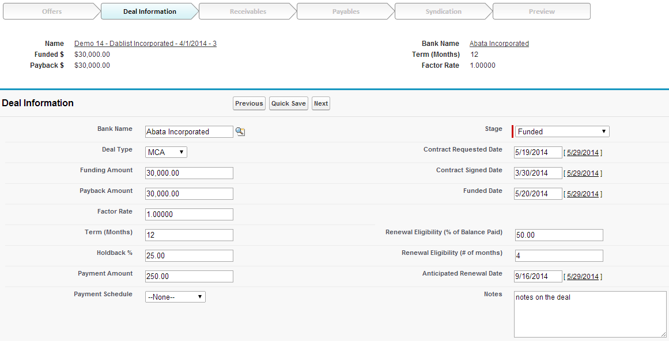
Deal Entry Wizard – Deals

Slide 8
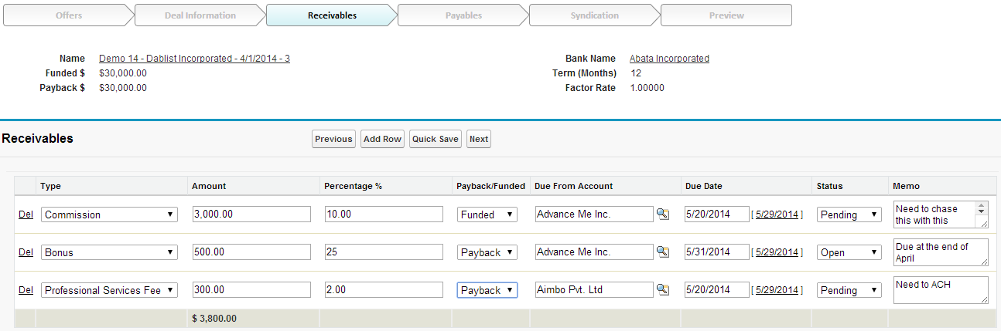
Deal Entry Wizard – Receivables

Slide 9
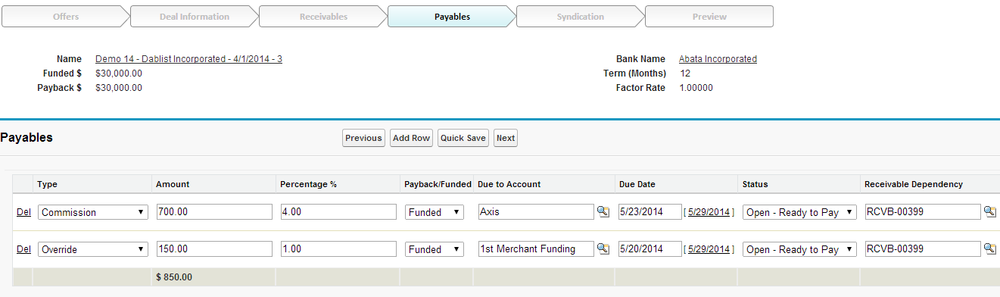
Deal Entry Wizard – Payables

Slide 10
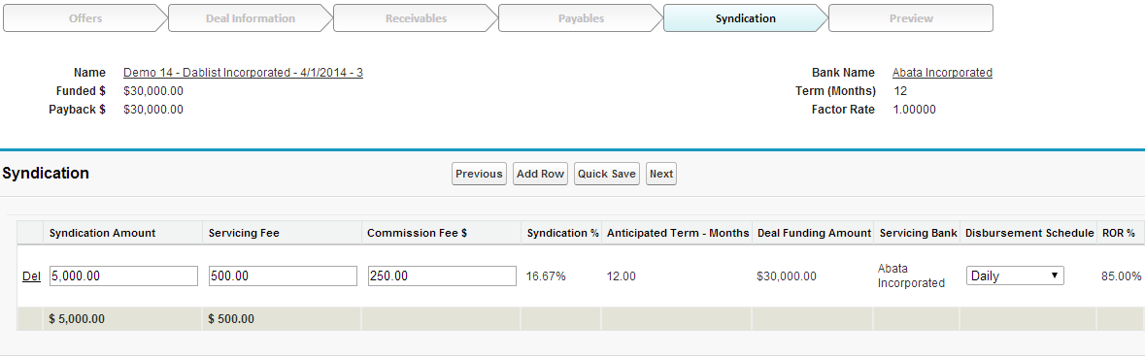
Deal Entry Wizard – Syndication

Slide 11
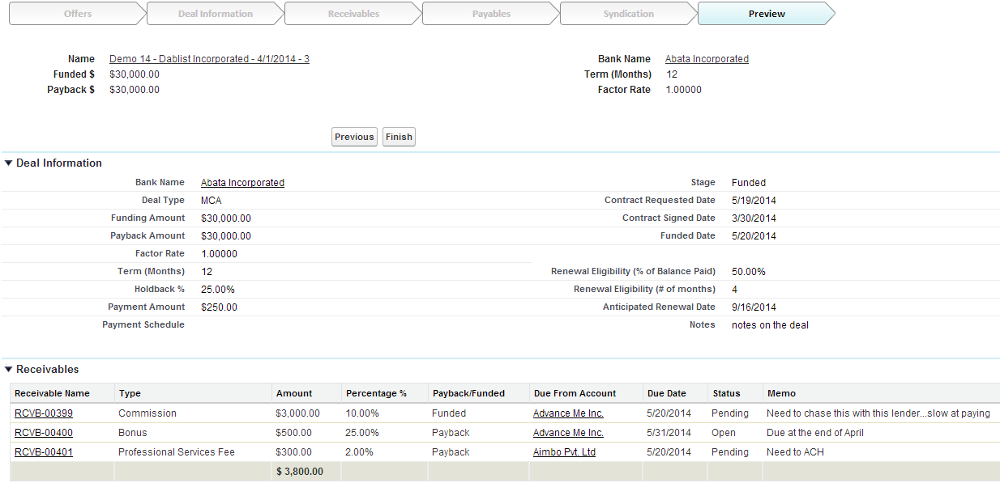
Deal Entry Wizard – Preview

Slide 12
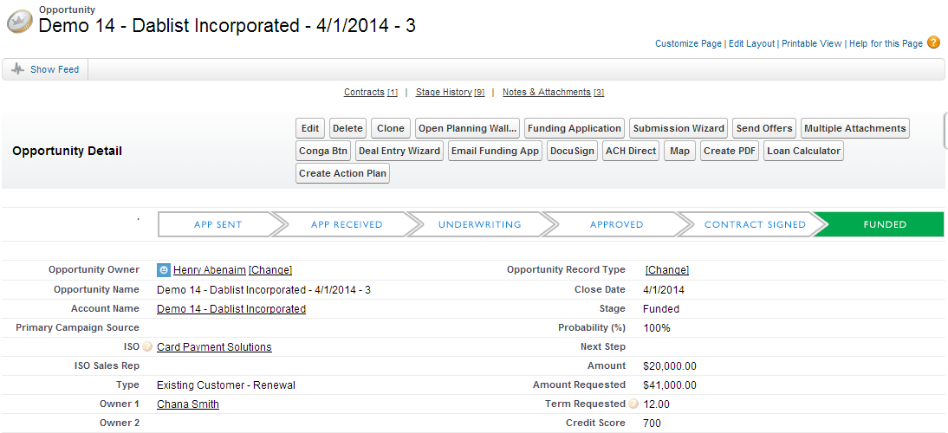
Deal Stage Tracking

Slide 13
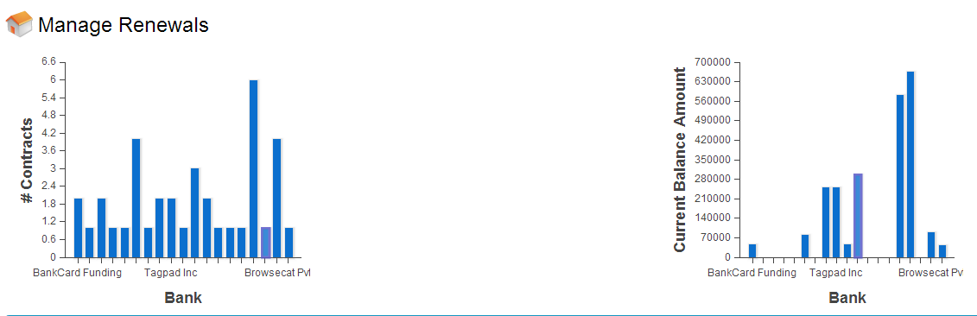
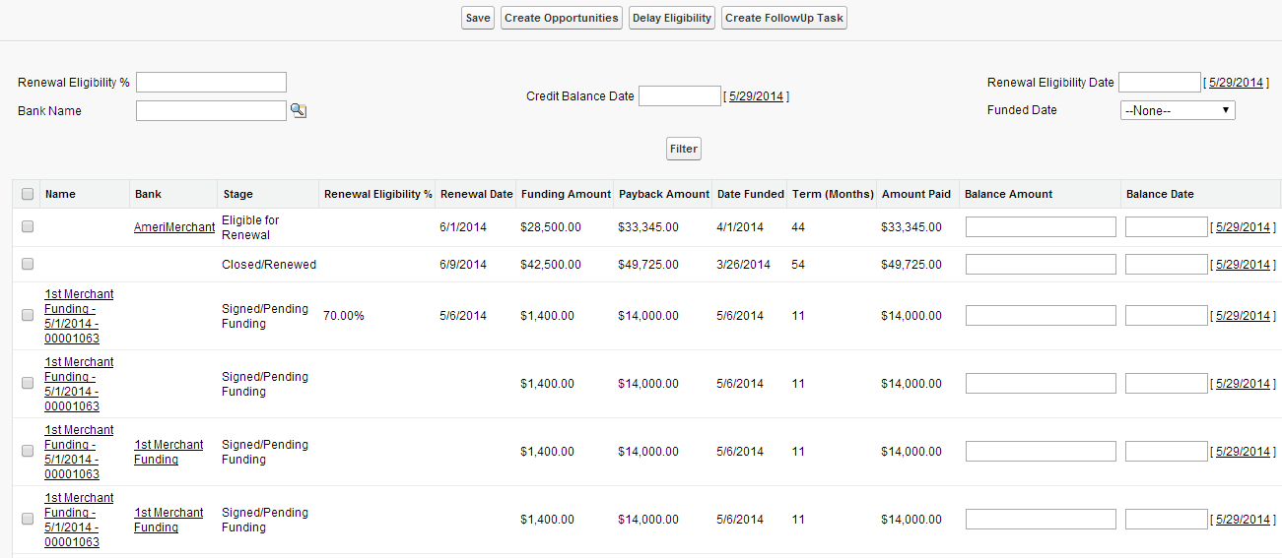
Manage Renewals

Slide 14
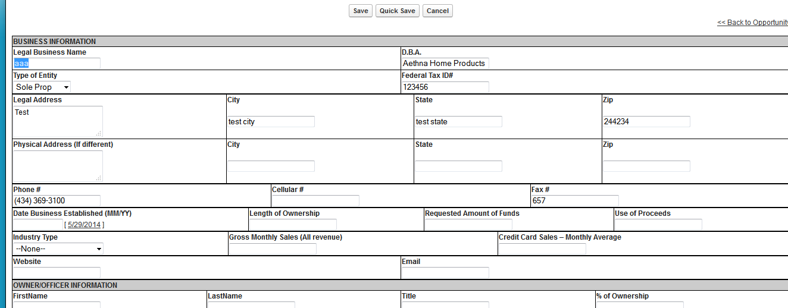
Funding Application

Slide 15
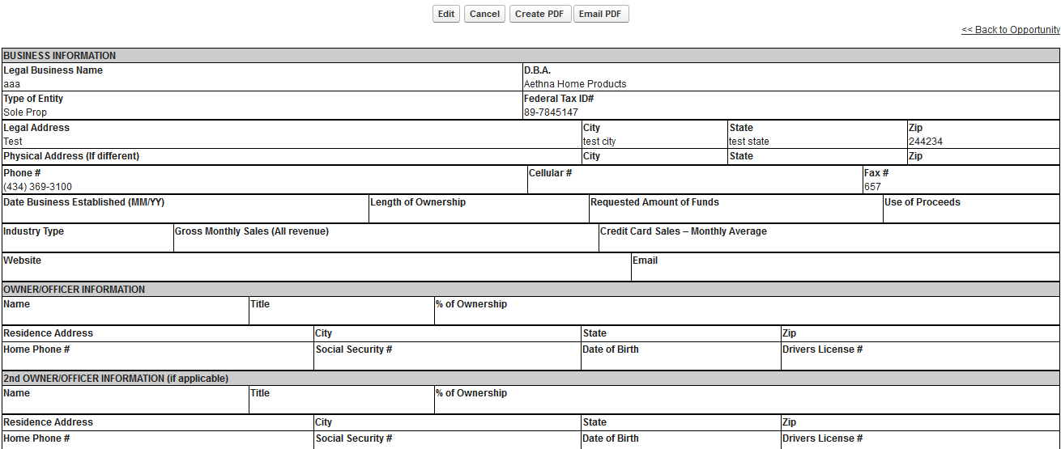
Funding Application – View

Slide 16
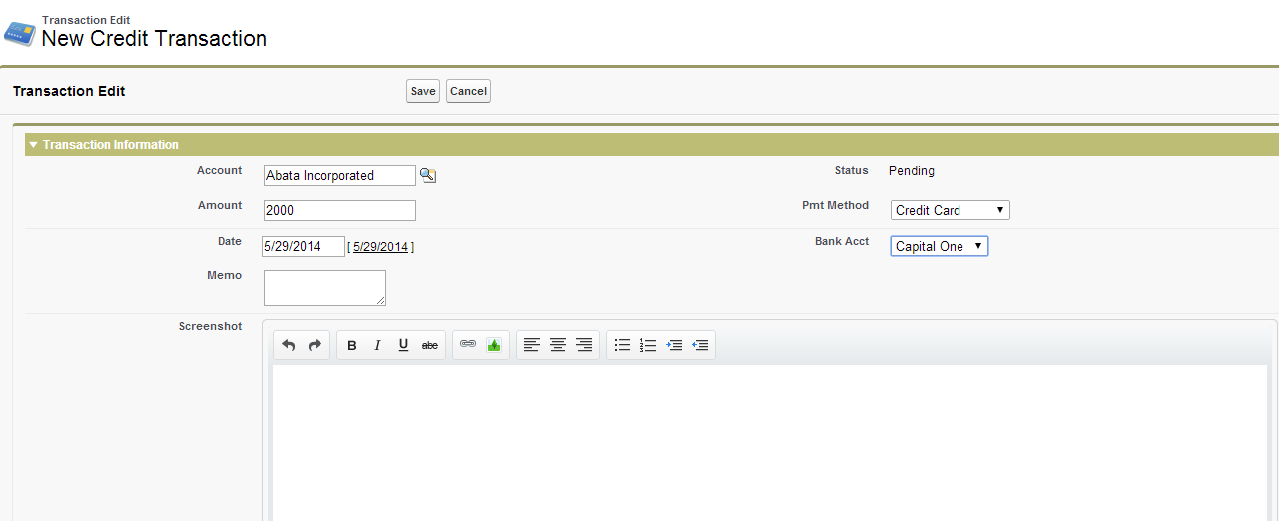
New Credit Transaction

Slide 17
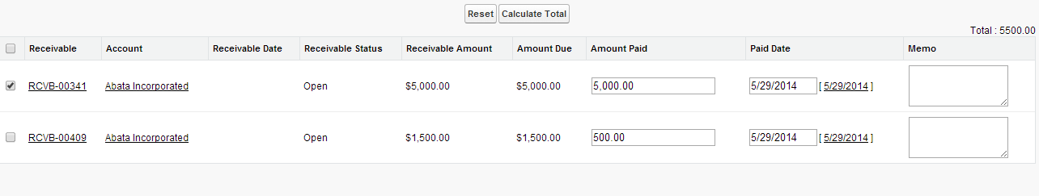
Transaction Receivables

Slide 18
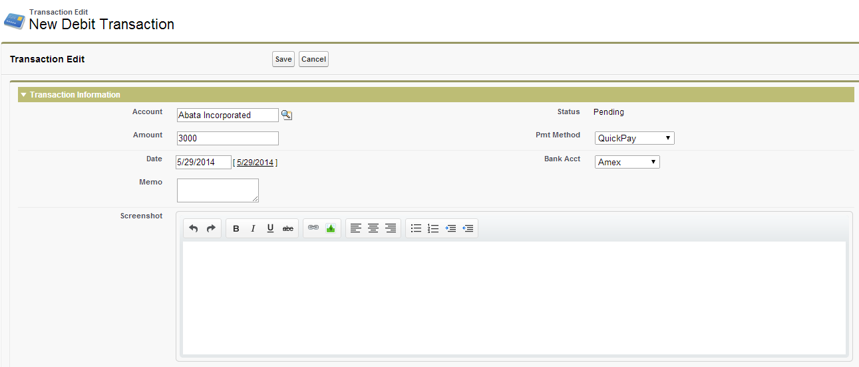
Debit Transaction Page

Slide 19
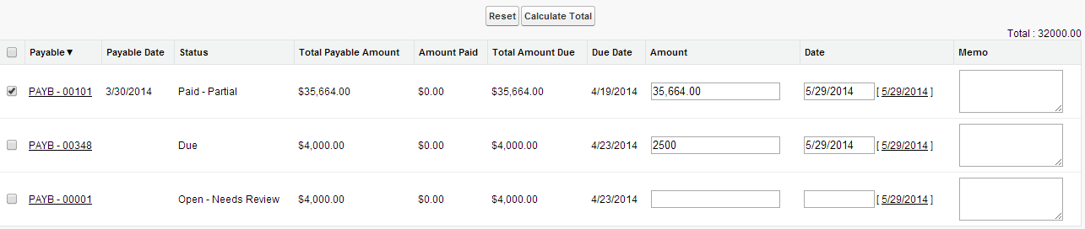
Debit Transaction Payables

